Slide 1
Introduction to Word Embeddings

Slide 2
Overview
What is a word embedding?
What sorts of word embeddings are there?
Count Vectors
TF-IDF Vectors
Word2Vec
GloVe
How do we evaluate word embeddings?

Slide 3
What is a word embedding?

Slide 4
What is a word embedding?
Before we can even think about building a model to make some predictions or analysis with text data, we need a way to represent words in a numeric way that computers can understand.
How do we represent “cat” as a collection of values that we can do some number crunching on?
A word embedding is a method or technique of converting words in our vocabulary into vectors that we can later feed in to down-stream machine learning and data science tasks.
Notes:
We need word embeddings before we can even think of applying of our ML algorithms to an NLP task.
Word embeddings are often “Step 0” of the NLP problem solving pipeline.

Slide 5
Count Vectors

Slide 6
Count Vectors
Consider a corpus of documents { D₁ , D₂ , … , D_{N} }
Suppose that after looking over all of our documents, we determine that we have V terms in our total vocabulary.
With this, we can create a document-term matrix with shape N x V which describes how many times a given term appears in a document.

Slide 7
Count Vectors
Consider this tiny corpus:
I like NLP
Learning machine learning is great
NLP is great
The document-term matrix is:
 | I | like | NLP | machine | learning | is | great
D₁ | 1 | 1 | 1 | 0 | 0 | 0 | 0
D₂ | 0 | 0 | 0 | 1 | 2 | 1 | 1
D₃ | 0 | 0 | 1 | 0 | 0 | 1 | 1

Slide 8
Count Vectors
With the document-term matrix, the document/word vectors are just the rows/columns!
The document vector for “I like NLP” is (1, 1, 1, 0, 0, 0)^{T}
The word vector for “NLP” is (1, 0, 1)^{T}
What are some pros and cons of this approach?
 | I | like | NLP | machine | learning | is | great
D₁ | 1 | 1 | 1 | 0 | 0 | 0 | 0
D₂ | 0 | 0 | 0 | 1 | 2 | 1 | 1
D₃ | 0 | 0 | 1 | 0 | 0 | 1 | 1
Notes:
Some responses might include:
+ Easy approach to understand
+ Vectors are easy to interpret
Doc-term matrix is very large and very sparse
Count/frequency based methods don’t carry much semantic information
Raw counts don’t control for document length

Slide 9
Term Frequency – Inverse Document Frequency

Slide 10
Term Frequency – Inverse Document Frequency
Term Frequency – Inverse Document Frequency (TF-IDF) is another popular method
TF-IDF builds upon raw count vectors in two ways
Using term frequency instead of raw counts (per document)
Also takes into account term frequency across the entire corpus
Stop words like “a”, “the”, “and”, etc. will appear in nearly every document. They add a lot of noise and not much information, so we would like to reduce their influence.

Slide 11


TF-IDF
TF-IDF has two components
Term Frequency: How frequently does each term appear in a document
Inverse Document Frequency: Across all documents, how often does a term appear?
TF-IDF just combines these two!
$$TF\left(t, d\right)= \frac{\# of times term t appears in document d}{Total number of terms in document d}$$
$$IDF\left(t, D\right)=\ln\left(1+ \frac{Total number of documents, D}{Number of documents containing term t}\right)$$
$$TFIDF\left(t,d,D\right)=TF\left(t,d\right) × IDF(t,D)$$
Notes:
IDF

Slide 12
TF-IDF
Pros
Simple to compute
Provides a simple basis for comparing the similarity of documents
Great tool for a lexical description of text
Cons
TF-IDF is based on a Bag-of-Words approach, and can’t capture positional information.
Cannot capture semantic information

Slide 13
Word2Vec

Slide 14
Word2Vec
The methods we have discussed work really well in some contexts, but there are several important ways they could be improved
Count/Frequency methods produce vectors which are very high-dimensional and very sparse
Count/Frequency methods really struggle to capture semantic relationships between words
But how do words actually get their meaning?
According to the Distributional Hypothesis, words that are used in similar contexts tend to have similar meaning

Slide 15
You shall know a word by the company it keeps.
– J. R. Firth

Slide 16
Word2Vec
Inspired by the Distributional Hypothesis, researchers started turning towards language models as a means of producing dense word vectors
A language model is just a way for us to assign probabilities to a sequence of words
“The cat sat on the mat” would have a relatively high probability (It is valid English)
“on cat the The sat mat” would have a relatively low probability (It is invalid English)
Notes:
One point that may be worth mentioning is clarifying the difference between the distributional hypothesis and distributed representations of word vectors.
Confusion can arise since the word “distribute” appears in both.
Distributional hypothesis -> Idea that words get their meaning based on the context they are used
Distributed representation -> The meaning of a word is “smeared” across various dimensions of the word vector. This is in contrast to a one-hot encoded or sparse representation.

Slide 17
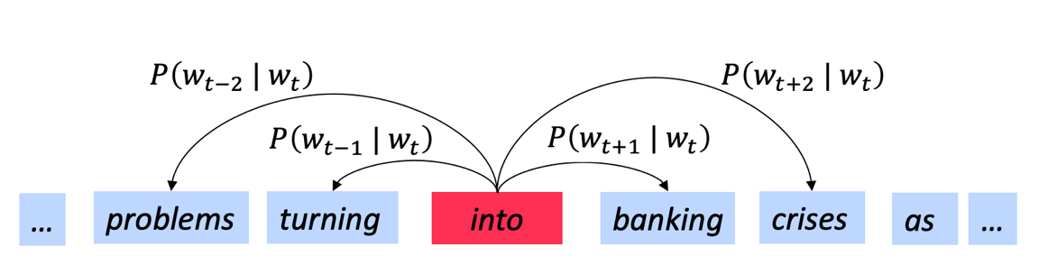
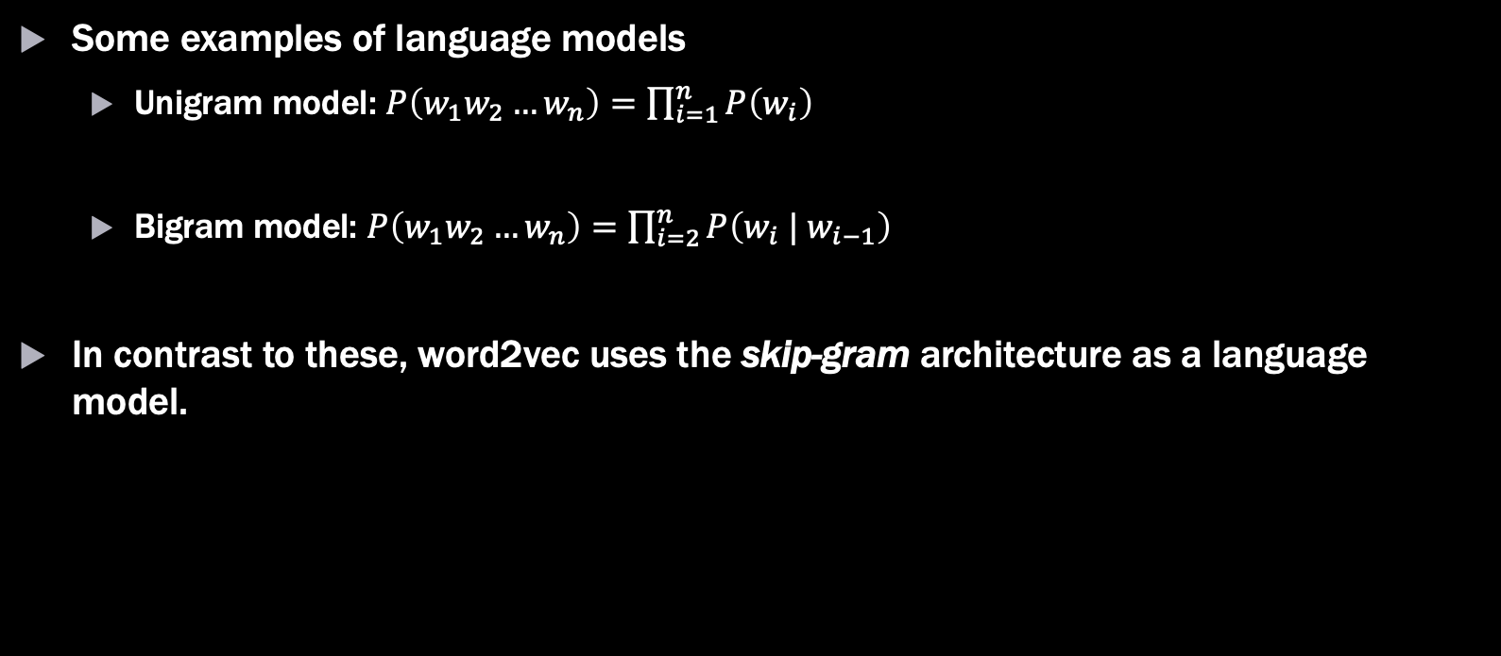
Word2Vec
Some examples of language models
Unigram model: $P\left(w_{1}w_{2}…w_{n}\right)=\prod_{i=1}^{n}{P\left(w_{i}\right) }$
Bigram model: $P\left(w_{1}w_{2}…w_{n}\right)=\prod_{i=2}^{n}{P\left(w_{i} | w_{i−1}\right)}$
In contrast to these, word2vec uses the skip-gram architecture as a language model.
http://web.stanford.edu/class/cs224n/lectures/lecture2.pdf

Slide 18


Word2Vec
http://web.stanford.edu/class/cs224n/lectures/lecture2.pdf
For each word in our corpus (t=1 … T) Predict the 2m surrounding words!
$J^{′}\left(θ\right)=\prod_{t=1}^{T}{\prod_{\begin{aligned}−m≤j≤m \\ j≠0\end{aligned}}{ P\left(w_{t+j} \right| w_{t} ;θ)}}$ ( 𝜃 denotes the word2vec model parameters)
As is customary in machine learning, we actually like to minimize things, so the cost function for word2vec is actually the negative log of the above
$J\left(θ\right)=−\left(\frac{1}{T}\right) \sum_{t=1}^{T}{\sum_{\begin{aligned}−m≤j≤m \\ j≠0\end{aligned}}{\ln{P\left(w_{t+j} \right| w_{t} ;θ)}}}$

Slide 19
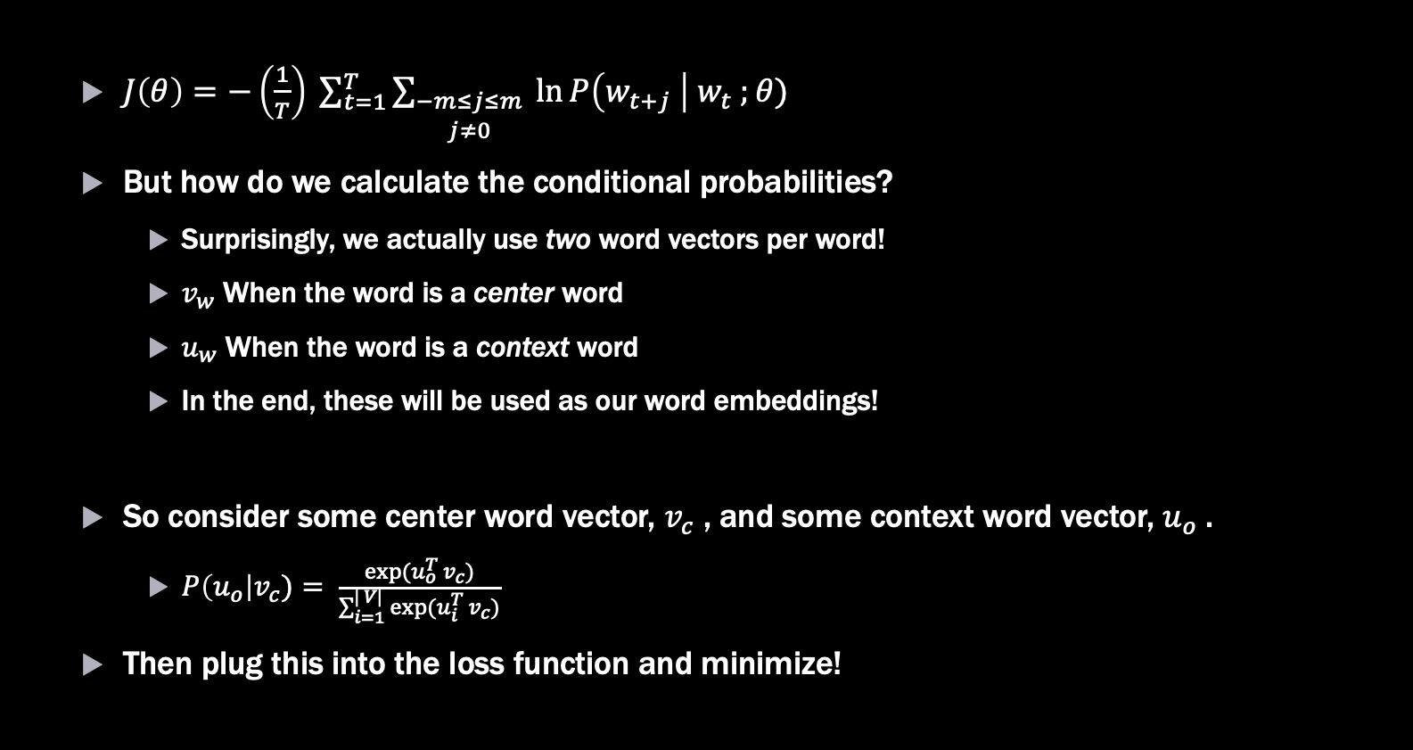
Word2Vec
$J\left(θ\right)=−\left(\frac{1}{T}\right) \sum_{t=1}^{T}{\sum_{\begin{aligned}−m≤j≤m \\ j≠0\end{aligned}}{\ln{P\left(w_{t+j} \right|{ w}_{t} ;θ)}}}$
But how do we calculate the conditional probabilities?
Surprisingly, we actually use two word vectors per word!
$v_{w}$ When the word is a center word
$u_{w}$ When the word is a context word
In the end, these will be used as our word embeddings!
So consider some center word vector, $v_{c}$ , and some context word vector, $u_{o}$.
$P\left(u_{o}\right|v_{c})= \frac{exp⁡(u_{o}^{T} v_{c})}{\sum_{i=1}^{| V|}{exp⁡(u_{i}^{T} v_{c})}}$
Then plug this into the loss function and minimize!

Slide 20
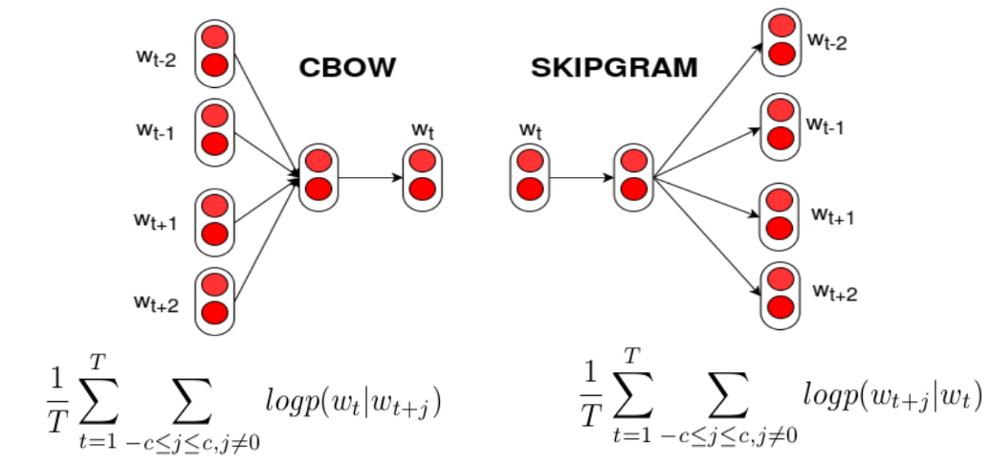
Word2Vec
In addition to the Skip-Gram version of word2vec, there is also the Continuous Bag-Of-Words (CBOW) architecture.
Skip-Gram and CBOW, are fundamentally similar, the main difference between them being that we flip our classification target.
https://eu.wikipedia.org/wiki/Word2vec

Slide 21
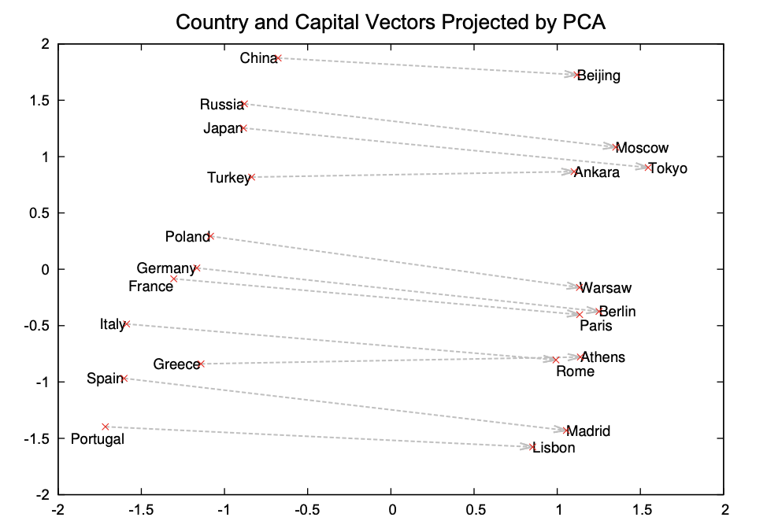
Word2Vec – Results!
Word2Vec showed a whole host of amazing results
Not only does it succeed in capturing semantic similarity, but it captures concepts!
“Distributed Representations of Words and Phrases and their Compositionality”
https://arxiv.org/abs/1310.4546
Notes:
The plot is a PCA projection of word2vec vectors. The striking observation is that the difference in word vectors is approximately constant.
The interpretation is that this vector difference is encapsulating the relationship of the City-Capital concept. i.e. if you know the capital of Spain, but had no idea about the capital of Portugal you could find it via: Vector(Portugal) + Vector(Madrid - Spain)
GloVe tries to extend this idea by building a model that explicitly encodes meaning into vector differences

Slide 22
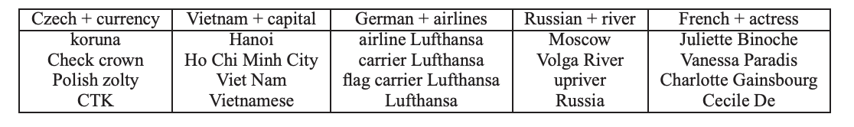
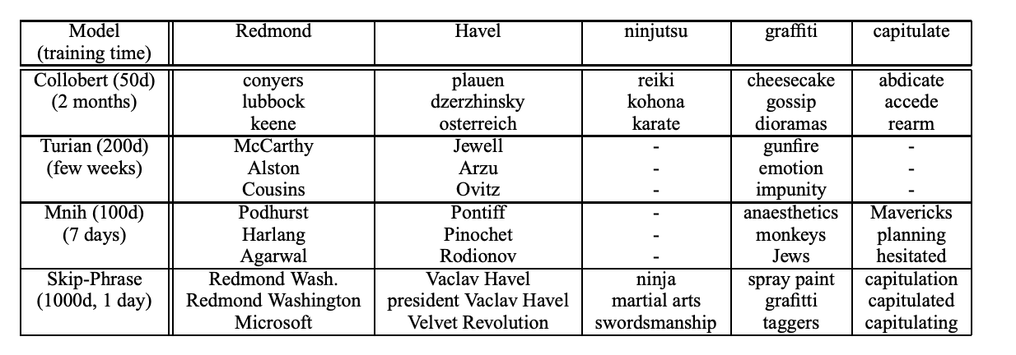
Word2Vec – Results!
We can add word2vec vectors together an get some amazing results!
How did word2vec compare to other state-of-the-art models at the time?
“Distributed Representations of Words and Phrases and their Compositionality”
https://arxiv.org/abs/1310.4546
“Distributed Representations of Words and Phrases and their Compositionality”
https://arxiv.org/abs/1310.4546
Notes:
These results slides are meant to be a bit of a mental break from some of the heavier math seen when introducing the model.

Slide 23
Word2Vec
Summary
Word2Vec is a word embedding method used to create word vectors
It does so by training a language model
Training the language model is a sort of “dummy” task
We actual don’t care about the model itself. It’s the model’s parameters that we use as word vectors!
Common architectures are Skip-Gram and CBOW
Skip-Gram is typically used for larger corpora
CBOW tends to work better for smaller corpora
Google provides pre-trained word2vec vectors that you can download and use!
There are excellent NLP libraries in Python to train your own word2vec model!

Slide 24
GloVe

Slide 25
GloVe
Word2Vec often works very well, but researchers quickly began looking into alternate methods
The Global Vector model (Pennington, Socher, & Manning) provides an alternate way to create dense representations of words
Rather than looking at context windows one at time, GloVe seeks to leverage global word co-occurrence statistics to produce word vectors

Slide 26
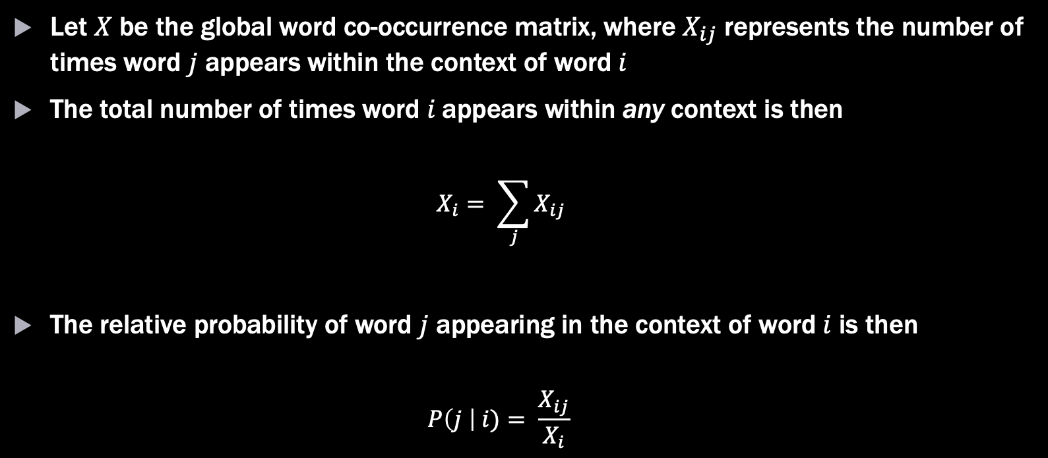
GloVe
Let $X$ be the global word co-occurrence matrix, where $X_{ij}$ represents the number of times word $j$ appears within the context of word $i$
The total number of times word $i$appears within any context is then
$$X_{i}= \sum_{j}{X_{ij}}$$
The relative probability of word $j$ appearing in the context of word $i$ is then
$$P\left(j \right| i)= \frac{X_{ij}}{X_{i}}$$

Slide 27
GloVe
Consider this tiny corpus with a context window size of 1:
I like NLP
Learning machine learning is great
NLP is great
 | I | Like | NLP | Learning | Machine | Is | Great
I | 0 | 1 | 0 | 0 | 0 | 0 | 0
Like | 1 | 0 | 1 | 0 | 0 | 0 | 0
NLP | 0 | 1 | 0 | 0 | 0 | 1 | 0
Learning | 0 | 0 | 0 | 0 | 2 | 1 | 0
Machine | 0 | 0 | 0 | 2 | 0 | 0 | 0
Is | 0 | 0 | 1 | 1 | 0 | 0 | 2
Great | 0 | 0 | 0 | 0 | 0 | 2 | 0

Slide 28
GloVe
One of the key insights of the GloVe model is that it is the ratios of co-occurrence probabilities that encodes meaning
 | x = solid | x = gas | x = water | x = random
P(x | ice) | Large | Small | Large | Small
P( x | steam) | Small | Large | Large | Small
P(x | ice) / P(x | steam) | Very large | Very small | ~ 1 | ~ 1
Notes:
- "solid" is a related to "ice" but it is not related to "steam", so it's ratio is large
- "gas" is related to "steam" but it is not related to "ice", so it's ratio is small
- Query words which are either common to both, or uncommon to both get washed out in the co-occurrence probability ratio

Slide 29
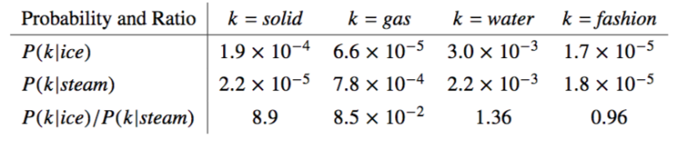
GloVe
One of the key insights of the GloVe model is that it is the ratios of co-occurrence probabilities that encodes meaning
Interesting idea! But how does the model actually work?
https://nlp.stanford.edu/pubs/glove.pdf

Slide 30
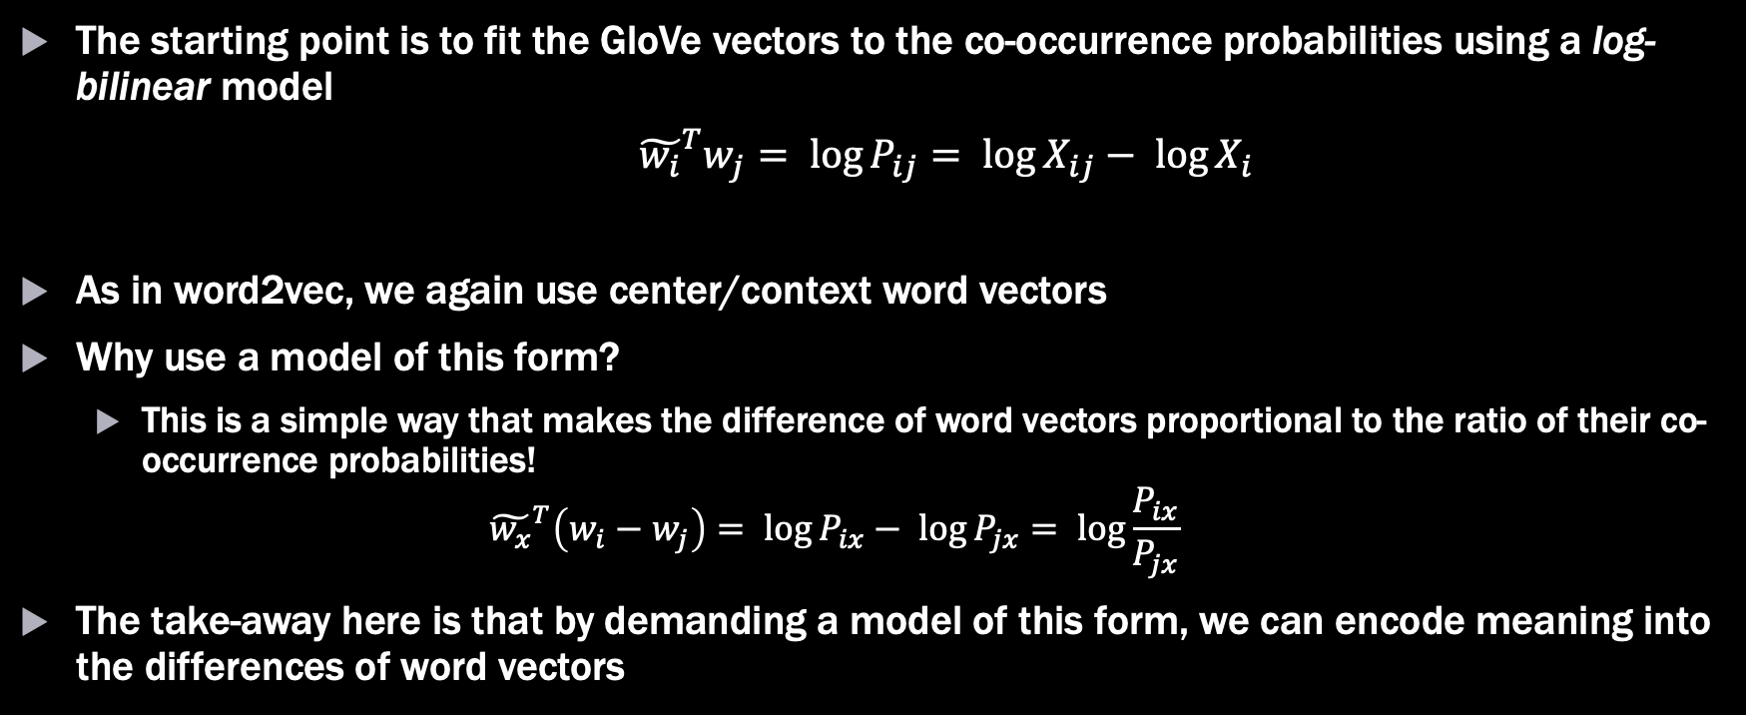
GloVe
The starting point is to fit the GloVe vectors to the co-occurrence probabilities using a log-bilinear model
${\tilde{w_{i}}}^{T}w_{j}= \log{P_{ij}}= \log{X_{ij}− \log{X_{i}}}$
As in word2vec, we again use center/context word vectors
Why use a model of this form?
This is a simple way that makes the difference of word vectors proportional to the ratio of their co-occurrence probabilities!
$${\tilde{w_{x}}}^{T}\left(w_{i}−w_{j}\right)= \log{P_{ix}− \log{P_{jx}= \log{\frac{P_{ix}}{P_{jx}}}}}$$
The take-away here is that by demanding a model of this form, we can encode meaning into the differences of word vectors
Notes:
- Just like in word2vec, we use two word vector representations for center/context words.
- Strictly speaking, this isn't necessary, but it's how GloVe is explained in the original paper.

Slide 31
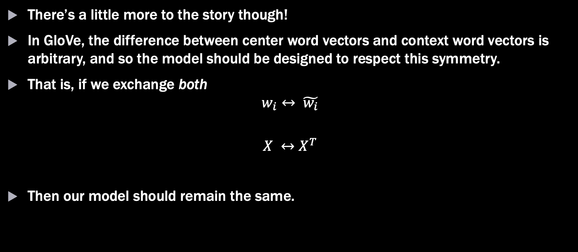
GloVe
There’s a little more to the story though!
In GloVe, the difference between center word vectors and context word vectors is arbitrary, and so the model should be designed to respect this symmetry.
That is, if we exchange both
$$w_{i}↔ \tilde{w_{i}}$$
$$X ↔X^{T}$$
Then our model should remain the same.

Slide 32


GloVe
Let’s see if this works! Recall the GloVe model so far,
Doing the exchange we get:
The exchange symmetry gets spoiled by the last term! We can fix this though by adding in a couple of bias vectors.
$${\tilde{w_{i}}}^{T}w_{j}= \log{X_{ij}− \log{X_{i}}}$$
$${\tilde{w_{j}}}^{T}w_{i}= \log{X_{ji}− \log{X_{i}}}$$

Slide 33

GloVe
Adding in these bias terms, we get
Great! But there is one last pestering detail (I promise!). How do we handle stop words?
GloVe introduces a weighting function to limit the effect of very frequent words.
$${\tilde{w_{i}}}^{T}w_{j}+b_{j}+ \tilde{b_{i}}= \log{X_{ij}}$$

Slide 34
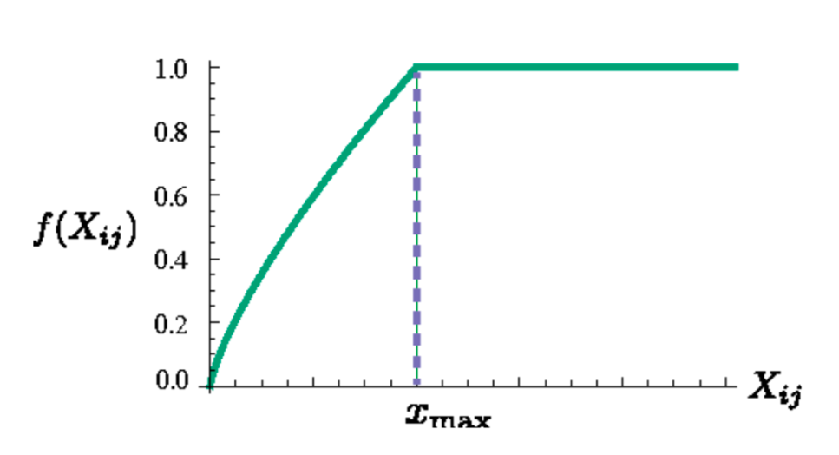

GloVe
The weighting function typically used in the GloVe model is
$$f\left(x\right)=\left\{\begin{aligned}{\left(\frac{x}{x_{max}}\right)}^{α}, x<x_{max} \\ &1, otherwise\end{aligned}\right.$$
https://nlp.stanford.edu/pubs/glove.pdf

Slide 35

GloVe
Incorporating this weighting function into the model, we finally arrive at the loss function for GloVe!
This is a weighted least-squares problem!
$$J= \sum_{i,j=1}^{|V|}{f\left(X_{ij}\right){\left({\tilde{w_{i}}}^{T}w_{j}+b_{j}+ \tilde{b_{i}} − \log{X_{ij}}\right)}^{2}}$$

Slide 36
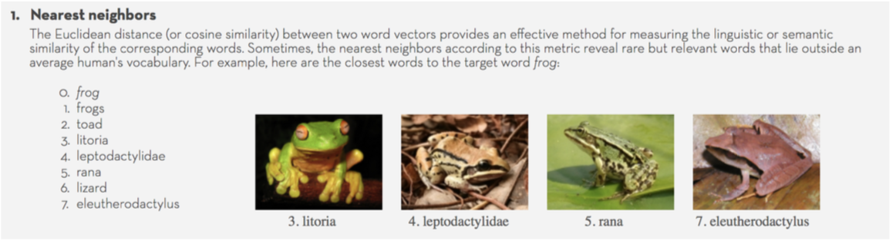
GloVe – Results!
https://nlp.stanford.edu/projects/glove/
Notes:
This results was pretty surprising to the GloVe authors.
The first closest neighbors were anticipated, but they were surprised to see the scientific names of frog species appear!

Slide 37
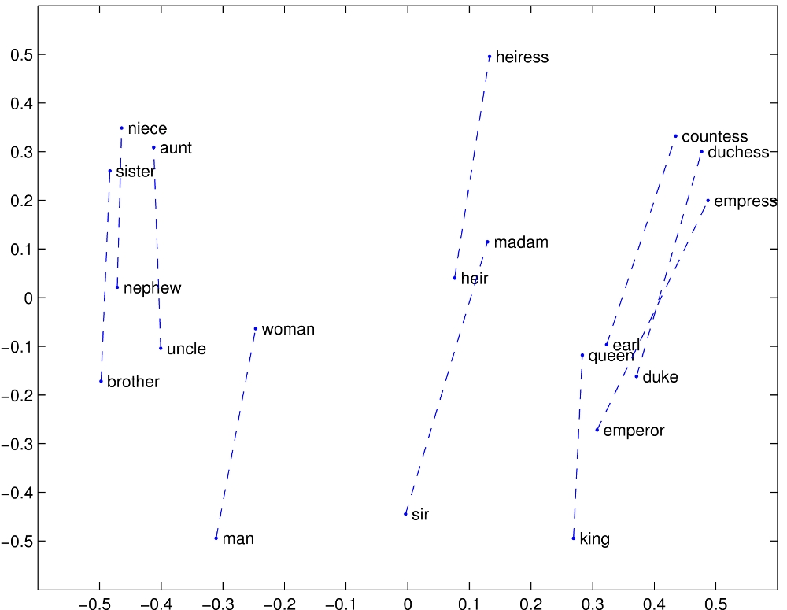
GloVe – Results!
https://nlp.stanford.edu/projects/glove/
Notes:
As in word2vec, we can see that GloVe is able to capture meaning within these word vector difference!

Slide 38
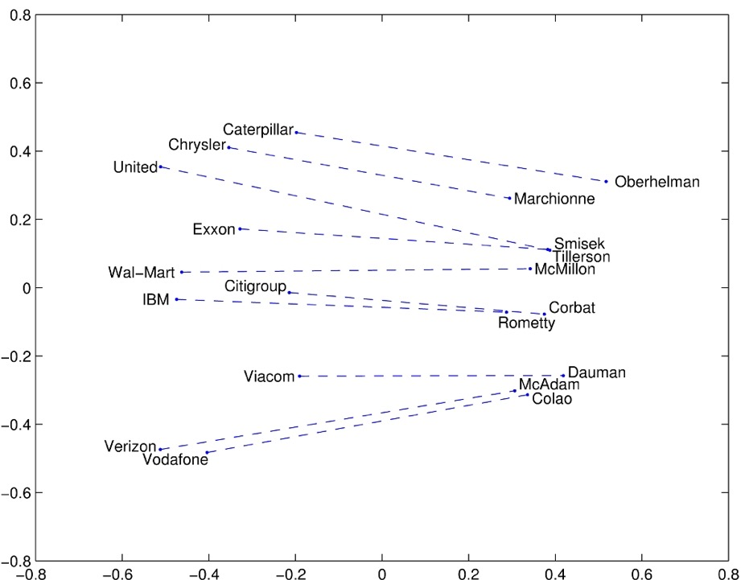
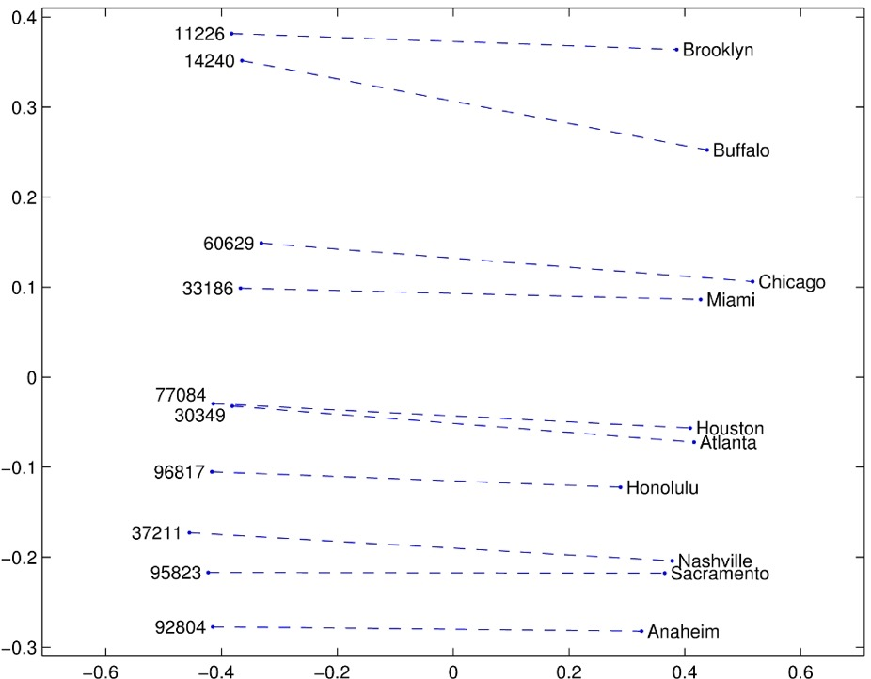
GloVe – Results!
https://nlp.stanford.edu/projects/glove/
Notes:
Amazingly, we can also capture concepts relating companies to their CEOs, and zip codes to cities!

Slide 39
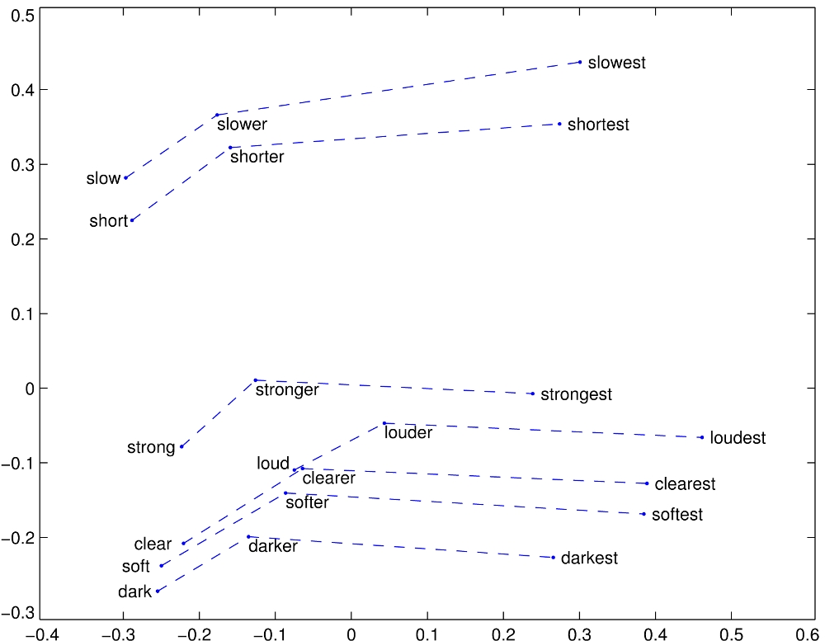
GloVe – Results!
https://nlp.stanford.edu/projects/glove/
Notes:
We can also see how this idea of encoding information in vector differences remains intact across comparatives and superlatives!

Slide 40
Evaluating Word Embeddings

Slide 41
Evaluating Word Embeddings
What makes up a “good” word embedding?
This is a tricky question! Word embeddings are typically used in service of some down-stream task (like classification).
We can’t use performance on this downstream task to evaluate the word embeddings.
To address this, Mikolov et al. (word2vec group) proposed analogy tasks!
Notes:
- We can't evaluate a word embedding based on downstream task performance b/c it becomes hard to attribute performance. i.e., is the model bad, or are the word embeddings bad?

Slide 42
Evaluating Word Embeddings
The challenge is to use word embeddings to complete analogies.
High performance on this task typically means the word embeddings better capture the “essence” of words.
a : b :: c : ?
King : Queen :: Man : Woman (Semantic Analogy)
Dance : Dancing. :: Swim : Swimming (Syntactic Analogy)

Slide 43

Evaluating Word Embeddings
How does this look mathematically?
Given the analogy task (a, b, c are given, word d is unknown):
a : b :: c : d
Our guess for word d, is whatever word has the largest cosine similarity
$$d= \max_{x}{\frac{{\left(w_{b} −w_{a}+w_{c}\right)}^{T}w_{x}}{\left\|w_{b} −w_{a}+w_{c}\right\| \left\|w_{x}\right\|}}$$

Slide 44
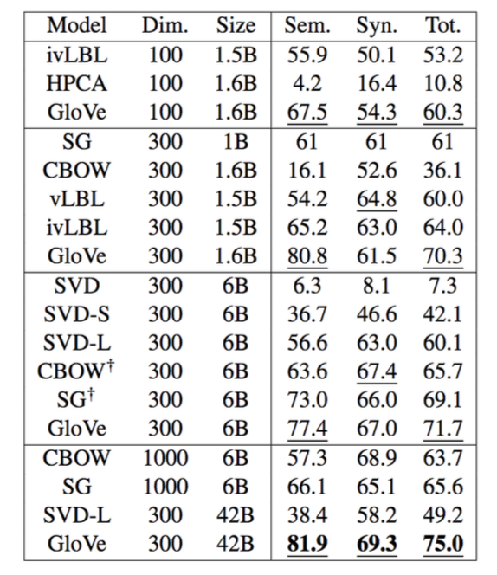
Evaluating Word Embeddings
How do various word embedding methods compare?
https://nlp.stanford.edu/pubs/glove.pdf

Slide 45
Beyond GloVe and Word2Vec

Slide 46
Beyond GloVe and Word2Vec
Word2Vec and GloVe are both excellent, but no model is ever perfect.
The word vectors produced by these models are static, and may have difficulty with word-sense disambiguation.
Does “bank” refer to the place I keep my money, or to a landscape feature near a river?
More recently, deep-learning methods have been used to create contextualized word embeddings to deal with this problem. Some notable examples:
ELMo
ULMFiT
OpenAI Transformer
BERT

Slide 47
Summary
Word embeddings solve of the problem of representing words/documents in a way that we can feed into other Data Science and Machine Learning tasks
Count Vectorization and TF-IDF vectors provide more intuitive methods for generating word embeddings
Using these methods along with bigrams/trigrams can yield pretty good results!
Word2Vec and GloVe are more advanced methods of creating dense representations of word vectors
The math of this might get a little sticky, but there are plenty of Python resources to handle things under-the-hood.
Performance on analogy tasks is the usual way we evaluate the efficacy of a word embedding

Slide 48
Further Reading
Great Blog Post on Word2Vec Intuition: http://mccormickml.com/2016/04/19/word2vec-tutorial-the-skip-gram-model/
GloVe Paper: https://nlp.stanford.edu/pubs/glove.pdf
Stanford Lecture notes on word vectors: http://web.stanford.edu/class/cs224n/lectures/lecture2.pdf
TensorFlow tutorial on word vectors: https://www.tensorflow.org/tutorials/representation/word2vec

